Slide 1
Hate Speech Detection
CSE 5367 – 001 Pattern Recognition
Instructor: YingYing Zhu
Team Members:
Keerthi Patnaik (1002069181)
Preethi Subramanian (1002059233)

Slide 2
Agenda
Introduction
Motivation & Problem Statement
Objectives
Methodology
Proposed Work
Current & Expected Outcomes
Evaluation Plan
Resources Required
Conclusion

Slide 3

Introduction
Develop a hate speech detection system to address toxicity, discrimination, and harm in the CrowdFlower tweet dataset.
Hate speech varies by target group, origin, and context. Words can signal hate speech or be harmless, depending on use.
Notes:
Introduction:
Just to give a quick overview of the project, we will be developing a toxic speech detection system addressing and identifying the toxic comments for which we will be using the CrowdFlower tweet dataset.
In this project we will be mainly focusing on the separation of hate speech from other instances of offensive language.
We aim to train a multi-class classifier on the crowdflower tweet dataset and categorize the tweets into 3 categories – only hate speech, only offensive language, and those with neither.
In this project we will be exploring Natural Language Processing (NLP) techniques and ML models and will be focusing on the development of more effective, accurate and context-based model for detecting and addressing the toxic text online.
-----------------------
Present the motivation behind selecting the specific topic and its potential impact on addressing existing challenges or advancing current methodologies:
Obviously it is very evident how the social media has evolved over the decade and how its growing steadily; Toxic online content has become a major issue in today’s world due to an exponential increase in the use of internet by people of different cultures and educational background. Due to the massive scale of the web, methods that automatically detect hate speech are required.

Slide 4
Motivation & Problem Statement
Motivated by the rise of hate speech online and its negative impact on individuals.
The paper titled "Detecting Hate Speech in Social Media" establishes lexical baselines using supervised classification (SVM) on a hate speech annotated dataset and achieved an accuracy of 78%.
Some of the limitation in the research paper that was identified are Feature Performance and distinguishing profanity from hate Speech
We aim to address the above challenges of accurately identifying and distinguishing hate speech and offensive language within the CrowdFlower tweet dataset.
Notes:
Motivation:
Motivated by the rise of hate speech online and its negative impact on individuals.
Discuss any existing literature or research gaps related to the chosen topic:
The paper titled "Detecting Hate Speech in Social Media" establishes lexical baselines using supervised classification methods like SVM on a dataset annotated for hate speech.
They utilize character n-grams, word n-grams, and word skip-grams as features and achieved an accuracy of 78% in identifying posts across three classes: hate speech, offensive language, and non-offensive content.
Distinguishing between hate speech and offensive language is a key challenge in the classification problem, emphasizing the importance of context in determining whether a tweet falls under hate speech
Some of the limitation in the research paper that was identified are being addressed and they are :
Feature Performance: While character n-grams perform well, other features like word bigrams and trigrams show degraded performance. The combination of all features does not achieve the best performance.
One of the key challenges that we are trying to address is differentiating hate speech and offensive language while detecting the toxic text content.
Although previous work on hate speech detection has identified this problem but many studies still tend to conflate hate speech and offensive language.
Clearly define the problem statement or research question that the project aims to address:
- here we are trying to address the challenges of accurately detecting hate speech and distinguish between hate speech and offensive language,

Slide 5
Objective
To develop a machine learning model capable of accurately identifying hate speech in diverse social media contexts.
Use supervised learning method to detect hate and offensive language.
Explore the use of advanced natural language processing techniques for hate speech classification.
Evaluate the model's performance using metrics such as precision, recall, and F1 score.
Notes:
Objectives:
• State the specific objectives of the project, outlining what you aim to achieve through your research or implementation efforts:
• Ensure that the objectives are realistic, measurable, and aligned with the scope of the project:

Slide 6

Methodology
Use CrowdFlower tweet dataset annotated for hate speech, to train and validate the models.
Utilize natural language processing (NLP) techniques for data preprocessing, feature extraction (TFIDF, sentiment analysis, Doc2Vec).
Implement machine learning algorithms like SVM, Naive Bayes, and Logistic Regression, Random Forest for classification.
Notes:
Methodology: -
In this we will be useing a hate speech lexicon compiled by Hatebase.org and manually labels tweets as hate speech, offensive language, or neither
• Describe the methodology or approach that you plan to follow to accomplish the project objectives:
• If applicable, discuss the algorithms, techniques, or frameworks that will be utilized in the project implementation:
• Provide details on any datasets or resources that will be used for training, testing, or validation:

Slide 7
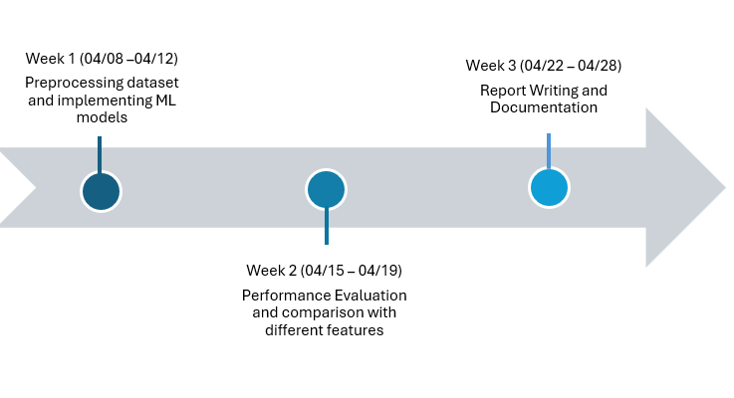
Proposed Work
Preprocessing tweet dataset from CrowdFlower.​
Use machine learning models to classify the processed texts.​
Create a variety of features for the classification task using TFIDF, sentiment analysis, Doc2Vec​
Finally, analyze the results obtained.

Slide 8
Current & Expected Outcomes
Current paper related to this topic has developed a SVM model to detect hate speech.
We expect this project to try other approach like Random Forrest, Logistic Regression, SVM, Naive Bayes to detect hate speech and some feature engineering compare their performance.

Slide 9
Evaluation Plan​
Evaluate different model performance based on metrics such as
Accuracy
Precision and Recall.
F1 Score
Confusion Matrix

Slide 10
Resources Required
Access to relevant software and programming environments (Python, Jupyter Notebooks).
Datasets: Hate speech datasets from CrowdFlower.
Libraries: scikit-learn, NLTK.

Slide 11
Conclusion
Upon completion of this project, our objective is to determine the best model in identifying hate speech, specifically quantifying the improvement in accuracy between the models.
By developing an effective hate speech detection model, we aim to contribute to the advancement of knowledge in the field of natural language processing.

Slide 12

Thank you!
Any Queries?

